Slide 1
UNIT 3
SS approach

Slide 2
Controllability & Observability

Slide 3
SS Approach..(modelling)
Any system (SISO or MIMO) can be modelled as a SS model ( which is defined in terms of matrices A, B, C &D)
Once modelled, we should be able to check for the key control system concepts …such as performance indices, stability and so on…

Slide 4
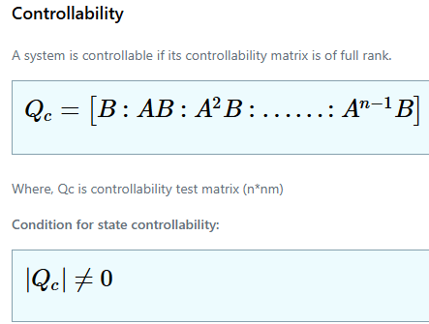
Controllability

Slide 5
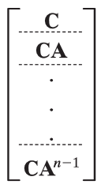
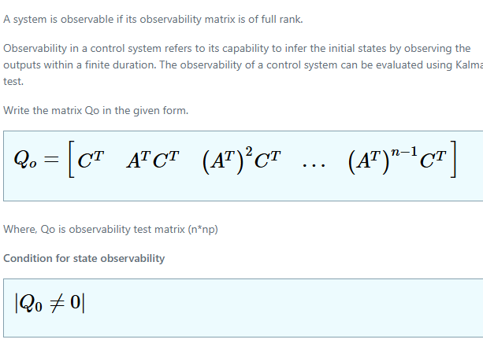
Observability

Slide 6
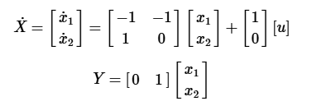

Hence
Check for controllability & Observability

Slide 7
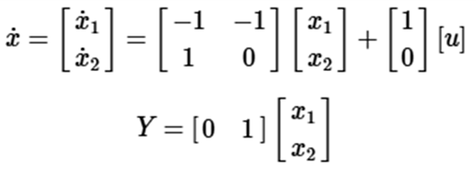
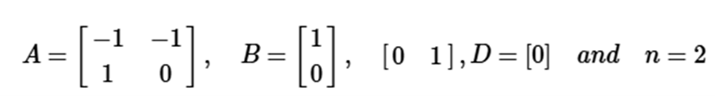
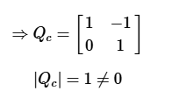
For n=2, the matrix Qc will be [ B AB]
Hence
controllable..

Slide 8

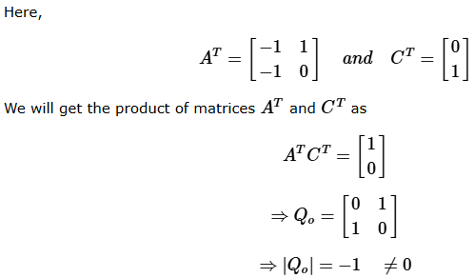
For n = 2, the matrix Qo will be
Since the det. Is not equal to zero, the system is observable.

Slide 9

If the determinant of the matrix is not equal to zero, then the system is controllable.
III^{ly} for observabilty, the rank of Qo matrix should be equal to n, or the determinant should not be equal to zero.

Slide 10
Observability matrix
A state-feedback controller is a control system design technique that uses the feedback of all state variables of a system to manipulate the system's input and achieve desired performance characteristics, often by placing poles in a desired location

Slide 11
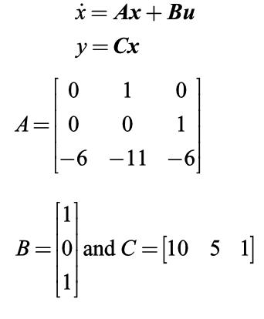
Problem:
For the following system described by the state equation, check for the complete state controllability and observability

Slide 12

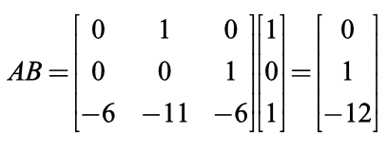
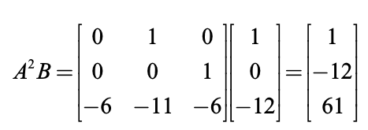
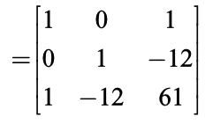
For checking the controllability:
The controllability matrix is given by
Controllability matrix
It is a non singular matrix

Slide 13
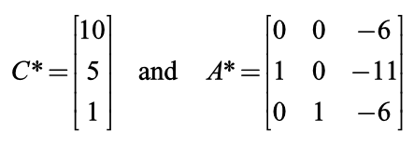

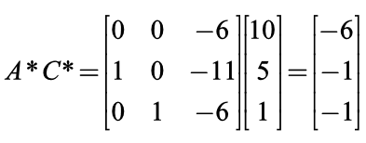
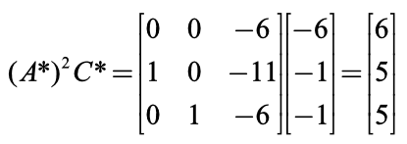
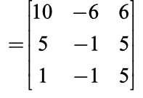
For checking the observability:
The respective matrix is given by
It is a non singular matrix

Slide 14
Tutorial…

Slide 15
Do the controllability & observability check..

Slide 16

Check Controllability & Observability

Slide 17
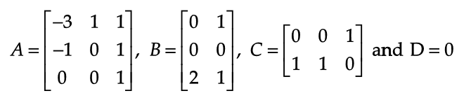
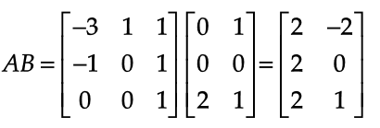
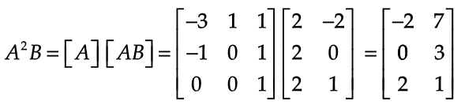
Check for the complete state controllability and observability for the state space system whose A,B and C matrices are given below
Check the controllability & Observability;
The controllability matrix is given by Qc

Slide 18
Check for the complete state controllability and observability for the state space system whose A,B and C matrices are given below
For checking the controllability:
The controllability matrix is given by Qc

Slide 19
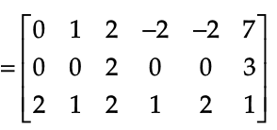

Slide 20

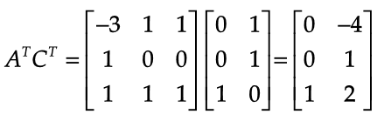
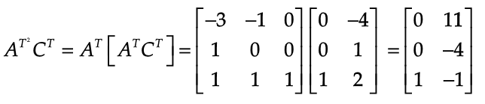
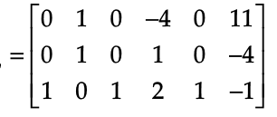
To check for observability
The observability matrix is

